Slide 1

Probability

Slide 2
PROBABILITY
Probability is the measure of how likely an event will occur.
To be more precise probability is the ratio of desired outcomes to total outcomes:
(desired outcomes) / (total outcomes)
The probabilities of all outcomes always sums up to 1. Consider the famous rolling dice example:
On rolling a dice, you get 6 possible outcomes
Each possibility only has one outcome, so each has a probability of 1/6
For example, the probability of getting a number ‘2’ on the dice is 1/6
Notes:
BasicStatisticsSampleExamples.xls - UseBoxPlot

Slide 3
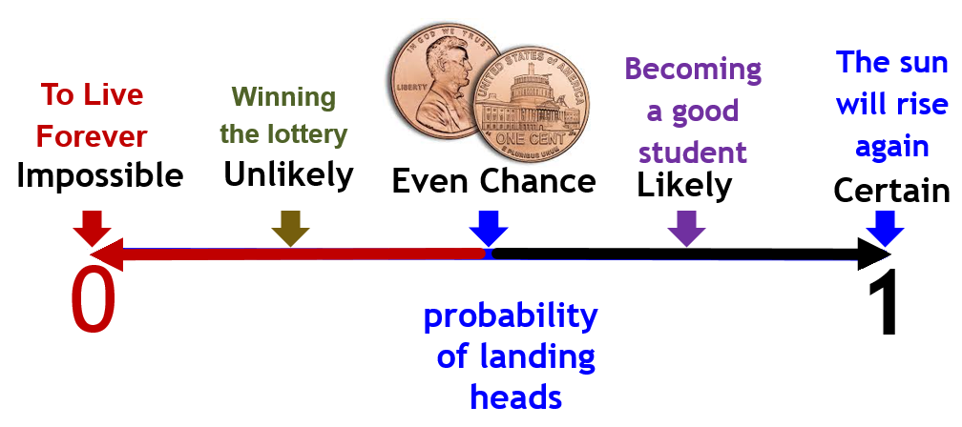
Probability Range
Probability is a numerical description of how likely an event is to occur. Probability is a number between 0 and 1.
Notes:
Probability is a numerical description of how likely an event is to occur .
The idea of probability is based on observation. Probability describes what happens over many, many trials.
P(A)= number of elements belonging to A
total number of elements in the sample spaceΩ
Probability is a number between 0 and 1.
The sum of the probabilities of all possible outcomes in a sample space is 1.
Probability theory is applied in day to day life in risk assessments and in trade on financial markets.
The ratio of the number of outcomes favorable for the event to the total number of possible outcomes is termed as probability.

Slide 4
Probability
What is Probability?
Probability is the measure of how likely an event will occur.
Number of times Event Occurred
P (𝐸) =
Total Number of opportunities for the event to have occurred

Slide 5


Probability
Probability Example
=
14
=
5
=
5
=
6
Total =
30
Find the Probability of finding a PURPLE FISH?

Slide 6

Probability
Probability Example
=
14
=
5
=
5
=
6
Total =
30
Find the Probability of finding a PURPLE FISH?
6
30
1
5
Probability
=
=

Slide 7
Probability Vs. Statistics

Slide 8
Probability Vs. Statistics
Probability and Statistics and related fields.
Probability is a mathematical method used for statistical analysis.
Therefore we can say that probability and statistics are interconnected branches of mathematics that deal with analyzing the relative frequency of events.
Notes:
BasicStatisticsSampleExamples.xls - UseBoxPlot

Slide 9
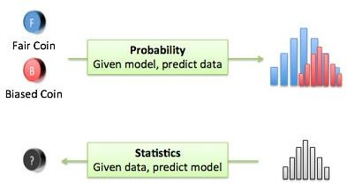


Probability Vs. Statistics
Predict the likelihood of a
future event
What will happen in a given
ideal world?
Probability is a method used in
Statistics
Probability
Analyze the past events
How ideal is the world?
Statistics

Slide 10
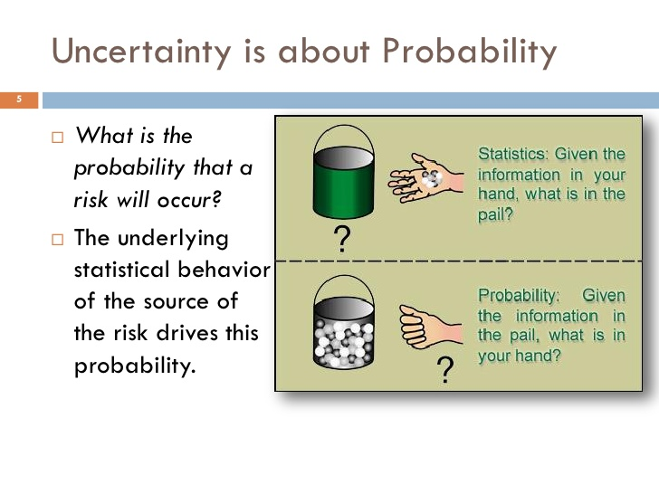
Probability Vs. Statistics

Slide 11
PROBABILITY
Probability is the measure of how likely an event will occur.
To be more precise probability is the ratio of desired outcomes to total outcomes:
(desired outcomes) / (total outcomes)
The probabilities of all outcomes always sums up to 1. Consider the famous rolling dice example:
On rolling a dice, you get 6 possible outcomes
Each possibility only has one outcome, so each has a probability of 1/6
For example, the probability of getting a number ‘2’ on the dice is 1/6

Slide 12
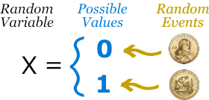
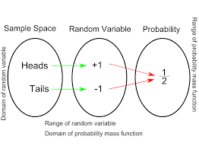
Random Variable (Probability)
A Random variable describes the probabilities for an uncertain future numerical outcome of a Random Process.
A random variable is a numerical description of the outcome of a statistical experiment.
It is a variable because it can take one or several possible Values
It is random because there is some change associated with Each possible value
Example: Tossing a coin: we could get Heads or Tails.
We have an experiment (such as tossing a coin) We give values to each event. The set of values is a Random Variable.
Notes:
Probability = Interested Events/Total Number of Events
Variable: When Output varies it is called a Variable, Coin Toss = 0 or 1
Random : When there is a Chance (probability) associated with getting a value 0 or 1 then it is Random
Coin Toss: 1/2
Dice : 6 Sides: 1/6
X = Radom Variable ( CAPITAL X)
x= the values associated with the Capital X Radom Variable is small x
X Coin Toss
The values H1 and T1 will be small x.
What is the difference between variable and random variable?
A variable is a quantity whose value changes. A discrete variable is a variable whose value is obtained by counting. A continuous variable is a variable whose value is obtained by measuring.
A random variable is a variable whose value is a numerical outcome of a random phenomenon.

Slide 13
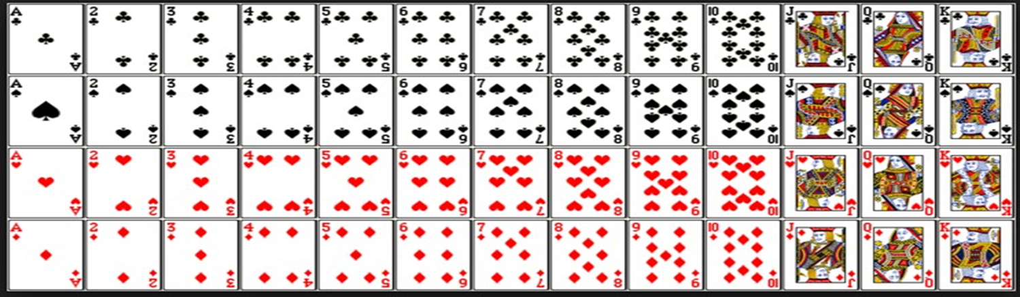
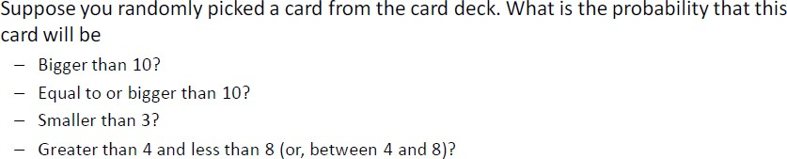
Probability
11
12
13
Notes:
Probability = Interested Events/Total Number of Events
Total number of Cards in Deck is 52
11 – J, 12 – Q, K -13
Bigger than 10 ? 3X4= 12 => 12/52
Equal or Bigger than 10 ? 4X4= 16 => 16/52
Smaller than 3 ? => 2X4 =8=> 8/52
Greater than 4 and Less than 8 => 5,6,7 => 3X4 =12 => 12/52

Slide 14
Probability Vs. Statistics

Slide 15
Probability Vs. Statistics
Probability and Statistics and related fields.
Probability is a mathematical method used for statistical analysis.
Therefore we can say that probability and statistics are interconnected branches of mathematics that deal with analyzing the relative frequency of events.

Slide 16
Probability Terminology

Slide 17



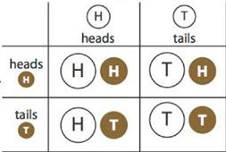

Probability Terminology
Probability Key Terms
Random
Experiment
Sample Space
Event
Outcome
A test to see what will happen in case you do something.
The total number of all different possible outcomes of a given experiment.
The set of a group of
different outcomes of an experiment.
Refers to a single (one)
result of an experiment.
Disjoint
Non Disjoint
Disjoint

Slide 18
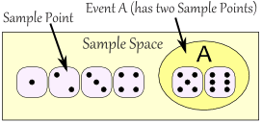
Sample space: the set of outcomes of an experiment is known as sample space.
Event: one or more outcomes in an experiment.
Sample point: each element of the sample space is called a sample point.
Events are denoted by capital letters A, B,C etc.

Slide 19
Disjoint (mutually exclusive) , Non – Disjoint (Not mutually Exclusive)
Disjoint Event(mutually Exclusive): Disjoint Events do not have any common outcomes.
For example, a single card drawn from a deck cannot be a king and a queen
Non – Disjoint Event (Not mutually Exclusive): Non-Disjoint Events can have common outcomes.
For example: a student can get 100 marks in statistics and 100 marks in probability

Slide 20
Probability Rules

Slide 21
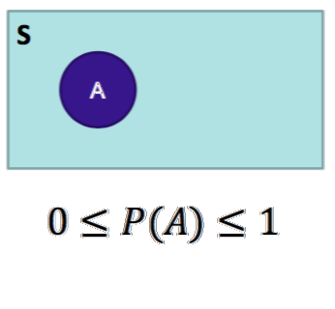
Probability Rules
Which are the important Probability Rules?

Slide 22
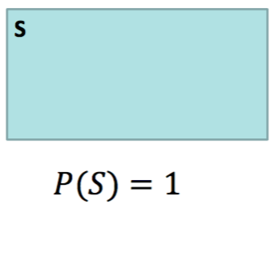
Probability Rules
Which are the important Probability Rules?

Slide 23
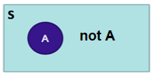
Probability Rules
Which are the important Probability Rules?

Slide 24
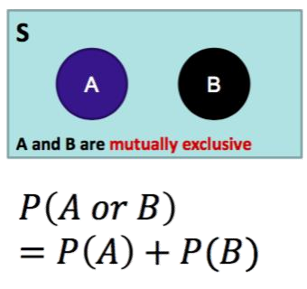
Probability Rules
Which are the important Probability Rules?

Slide 25
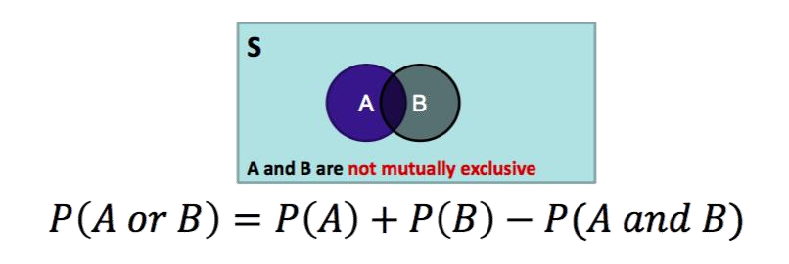
Probability Rules
Which are the important Probability Rules?

Slide 26

Independent Events
What are Independent Events?
The outcome of the event B is not dependent on the outcome of the event A
2 events A and B defined on a sample space are said to be independent if and only if
Probability of A intersection B = Probability of A * Probability of B
P(A and B) = P(A) * P(B)
Probability of A INTERSECTION B = AND
Notes:
https://www.mathgoodies.com/lessons/vol6/independent_events

Slide 27
CONDITIONAL Probability

Slide 28
Conditional Probability
Conditional Probability
P(B|A) = ^{P(A∩B)}
P(A)
or
P(A∩B) = P(A)*P(B|A)
Conditional Probability
P(B|A)=(P(A and B)/P(A) -->
Probability of B occurring Given(|) A has occurred = Probability of A and B/Probability of A

Slide 29
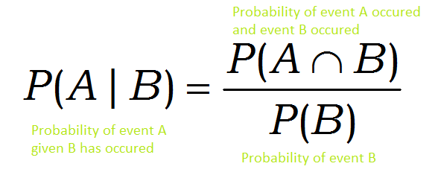
CONDITIONAL PROBABILITY
Notes:
Conditional probability is the probability of one event occurring with some relationship to one or more other events.

Slide 30
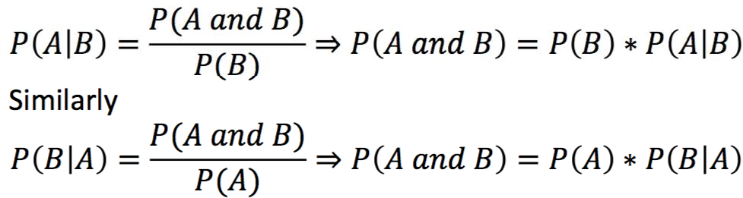
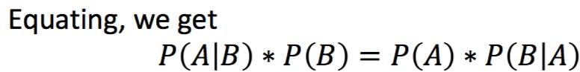
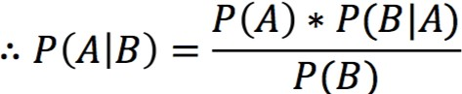
BAYES THEOREUM
(A given B )NOT EQUAL (B given A)
(A given B ) EQUAL (B given A) then it is BAYES THEOREUM
(A given B ) EQUAL (B given A), however final values will not be equal

Slide 31
BAYES THEOREUM
Bayes Theorem that is derived from Conditional Probability
P(A|B)=(P(A)*P(B|A))/P(B) -->
Probability of A occurring provided B has already occurred = Probability of A * Probability of B when A has occurred/Probability of B

Slide 32
Conditional Probability
P(A|B)=P(A intersection B)/P(B) -->
Probability of A occurring provided B has already occurred =
Probability of A * Probability of B when A has occurred/Probability of B
We have a show that has USED cars SHOWROOM
70% of the Cars have A/C(Air Conditions)
40% of the cards have CD players
20 % of the Cars have BOTH ( A/C and CD Players)
What is the Probability that the car has a CD Player given it has and A/C? P( CD | AC) ?

Slide 33
CONDITIONAL PROBABILITY
Of the cars on a used car lot, 70% have air conditioning and 40% have CD player and 20% of the cars have both.
 | CD | No CD | Total
AC | 0.2 | 0.5 | 0.7
No AC | 0.2 | 0.1 | 0.3
Total | 0.4 | 0.6 | 1.0
What is the probability that a car has a CD player , given that it has AC?
P(CD and AC)
P(CD | AC)=
P(AC)
=0.2/0.7 =0.2857
Notes:
Took this example from “slideplayer”.
Link: https://slideplayer.com/slide/4547729/
One more assignment

Slide 34
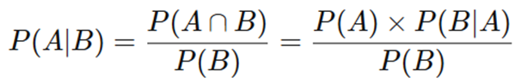
Bayes’ Theorem
In probability theory and statistics, Bayes' theorem describes the probability of an event, based on prior knowledge of conditions that might be related to the event.
Probability of B occurring given A has already occurred
Probability of A occurring
Probability of A occurring given B has already occurred
Probability of B occurring

Slide 35


example
Machine 1
Some of the wrenches produce by both machines are defective.
Machine 2
What is the probability of machine 2 producing defective wrenches?
Notes:
https://corporatefinanceinstitute.com/resources/knowledge/other/bayes-theorem/

Slide 36
Bayes theorem
Machine1: 30 wrenches/hr and Machine2: 20 Wrenches/hr
Out of all 1% are defective at the end of the day(say), out of all defectives 50% defectives are from machine1 and 50% are from machine2.
P(Mach1)=30/50=0.6 and P(Mach2)=20/50=0.4
P(Defect)=1%
P(Mach1 | Defect) = 50% and P(Mach2 | Defect) = 50%
P(Defect | Mach2)= ?
Notes:
Link for exaple: http://diamondclover.com/bayes.html

Slide 37
Bayes’ theorem
P(Mach2 | Defect) * P(Defect)
P(Defect | Mach2) =
P(Mach2)
0.5 * 0.01
=
=
0.0125
0.4
So it concludes that 1.25% will be the defective wrenches.

Slide 38


Slide 39
Probability Distribution

Slide 40
Random Variable (Probability)
A Random variable describes the probabilities for an uncertain future numerical outcome of a Random Process.
A random variable is a numerical description of the outcome of a statistical experiment.
It is a variable because it can take one or several possible Values
It is random because there is some change associated with Each possible value
Example: Tossing a coin: we could get Heads or Tails.
We have an experiment (such as tossing a coin) We give values to each event. The set of values is a Random Variable.
Notes:
Probability = Interested Events/Total Number of Events
Variable: When Output varies it is called a Variable, Coin Toss = 0 or 1
Random : When there is a Chance (probability) associated with getting a value 0 or 1 then it is Random
Coin Toss: 1/2
Dice : 6 Sides: 1/6
X = Radom Variable ( CAPITAL X)
x= the values associated with the Capital X Radom Variable is small x
X Coin Toss
The values H1 and T1 will be small x.
What is the difference between variable and random variable?
A variable is a quantity whose value changes. A discrete variable is a variable whose value is obtained by counting. A continuous variable is a variable whose value is obtained by measuring.
A random variable is a variable whose value is a numerical outcome of a random phenomenon.

Slide 41
What IS probability distribution ?
A probability distribution is a statistical function that describes all the possible values and likelihoods that a random variable can take within a given range. This range will be bounded between the minimum and maximum possible values, but precisely where the possible value is likely to be plotted on the probability distribution depends on a number of factors. These factors include the distribution's mean (average), standard deviation, skewness, and kurtosis.
What is a probability distribution example?
A probability distribution for a particular random variable is a function or table of values that maps the outcomes in the sample space to the probabilities of those outcomes. For example, in an experiment of tossing a coin twice, the sample space is. {HH, HT, TH, TT}.
Notes:
In an experiment of tossing a coin twice, the sample space is. {HH, HT, TH, TT}, this is a Binomial Distribution

Slide 42
Probability
What is probability distribution used for?
Probability can be used for more than calculating the likelihood of one event; it can summarize the likelihood of all possible outcomes. ... Probability distributions summarize the relationship between possible values and their probability for a random variable.
How do you find the probability distribution?
To calculate this, we multiply each possible value of the variable by its probability, then add the results. Σ (xi × P(xi)) = { x1 × P(x1)} + { x2 × P(x2)} + { x3 × P(x3)} + ... E(X) is also called the mean of the probability distribution.

Slide 43
Types of Probability Distributions
There are many different classifications of probability distributions. Some of them include the normal distribution, chi square distribution, binomial distribution, and Poisson distribution. The different probability distributions serve different purposes and represent different data generation processes. The binomial distribution, for example, evaluates the probability of an event occurring several times over a given number of trials and given the event's probability in each trial. and may be generated by keeping track of how many free throws a basketball player makes in a game, where 1 = a basket and 0 = a miss. Another typical example would be to use a fair coin and figuring the probability of that coin coming up heads in 10 straight flips. A binomial distribution is discrete, as opposed to continuous, since only 1 or 0 is a valid response.

Slide 44
Types of Probability Distributions
There are many different classifications of probability distributions. Some of them include the
normal distribution,
chi square distribution,
binomial distribution,
and Poisson distribution.

Slide 45
Purpose of Probability Distributions
The different probability distributions serve different purposes and represent different data generation processes.
The binomial distribution, for example, evaluates the probability of an event occurring several times over a given number of trials and given the event's probability in each trial. and may be generated by keeping track of how many free throws a basketball player makes in a game, where 1 = a basket and 0 = a miss. Another typical example would be to use a fair coin and figuring the probability of that coin coming up heads in 10 straight flips. A binomial distribution is discrete, as opposed to continuous, since only 1 or 0 is a valid response.

Slide 46
Normal Distribution

Slide 47
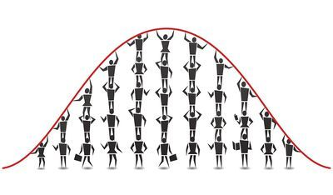
Examples of Normal Distribution
Height of the population is the example of normal distribution. Most of the people in a specific population are of average height. The number of people taller and shorter than the average height people is almost equal, and a very small number of people are either extremely tall or extremely short. However, height is not a single characteristic, several genetic and environmental factors influence height. Therefore, it follows the normal distribution.
Notes:
More examples of normal distribution
https://statisticsbyjim.com/basics/normal-distribution/
Data science normal distribution examples
https://www.analyticsvidhya.com/blog/2020/04/statistics-data-science-normal-distribution/

Slide 48
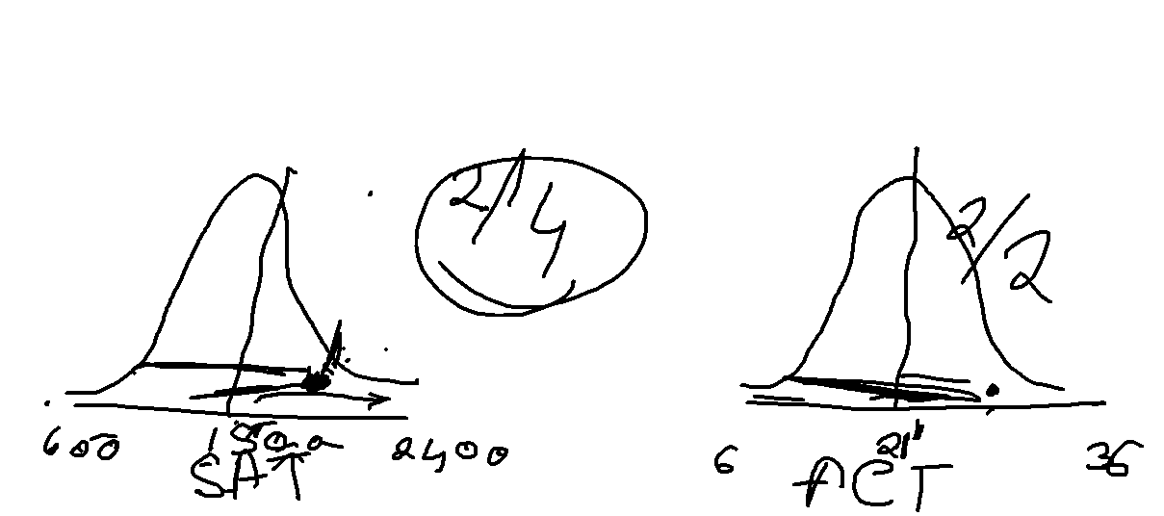
There are 2 students Ram and Sham. Ram Scored 1800 in his SAT exam. Sham scored 24 in his ACT Exam. Did Ram or Sham score better?
SAT Score Mean = 1500, Standard Deviation = 300
ACT Score Mean = 21, Standard Deviation = 5
Did Ram or Sham score better?

Slide 49
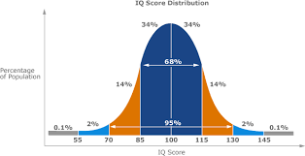

Slide 50
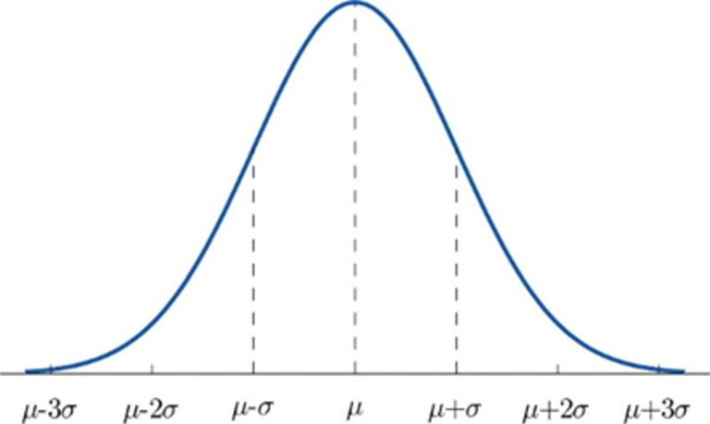
Normal Distribution
Normal distribution, otherwise known as the Gaussian distribution, is a probability distribution that denotes the symmetric property of the mean. The idea behind this function is that the data near the mean occurs more frequently than the data away from the mean. It infers that the data around the mean represents the entire data set.
Similar to PDF(Probability Density Function), the normal distribution appears as a bell curve:
Notes:
For example, heights, blood pressure, measurement error, and IQ scores follow the normal distribution. It is also known as the Gaussian distribution and the bell curve.
https://en.wikipedia.org/wiki/Probability_density_function
Suppose bacteria of a certain species typically live 4 to 6 hours. The probability that a bacterium lives exactly 5 hours is equal to zero. A lot of bacteria live for approximately 5 hours, but there is no chance that any given bacterium dies at exactly 5.0000000000... hours. However, the probability that the bacterium dies between 5 hours and 5.01 hours is quantifiable. Suppose the answer is 0.02 (i.e., 2%). Then, the probability that the bacterium dies between 5 hours and 5.001 hours should be about 0.002, since this time interval is one-tenth as long as the previous. The probability that the bacterium dies between 5 hours and 5.0001 hours should be about 0.0002, and so on.
In these three examples, the ratio (probability of dying during an interval) / (duration of the interval) is approximately constant, and equal to 2 per hour (or 2 hour⁻¹). For example, there is 0.02 probability of dying in the 0.01-hour interval between 5 and 5.01 hours, and (0.02 probability / 0.01 hours) = 2 hour⁻¹. This quantity 2 hour⁻¹ is called the probability density for dying at around 5 hours. Therefore, the probability that the bacterium dies at 5 hours can be written as (2 hour⁻¹) dt. This is the probability that the bacterium dies within an infinitesimal window of time around 5 hours, where dt is the duration of this window. For example, the probability that it lives longer than 5 hours, but shorter than (5 hours + 1 nanosecond), is (2 hour⁻¹)×(1 nanosecond) ≈ 6×10⁻¹³ (using the unit conversion 3.6×10¹² nanoseconds = 1 hour).
There is a probability density function f with f(5 hours) = 2 hour⁻¹. The integral of f over any window of time (not only infinitesimal windows but also large windows) is the probability that the bacterium dies in that window.

Slide 51
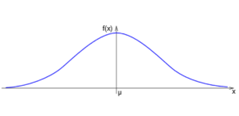
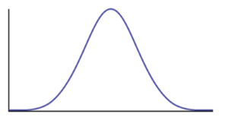
Normal Distribution
The graph of the Normal Distribution depends on two factors: the Mean and the Standard Deviation. Mean: Determines the location of the center of the graph
Standard Deviation: Determines the height of the graph
If the standard deviation is large, the curve is short and wide.
If the standard deviation is small, the curve is short and wide.
Notes:
https://en.wikipedia.org/wiki/Probability_density_function
Suppose bacteria of a certain species typically live 4 to 6 hours. The probability that a bacterium lives exactly 5 hours is equal to zero. A lot of bacteria live for approximately 5 hours, but there is no chance that any given bacterium dies at exactly 5.0000000000... hours. However, the probability that the bacterium dies between 5 hours and 5.01 hours is quantifiable. Suppose the answer is 0.02 (i.e., 2%). Then, the probability that the bacterium dies between 5 hours and 5.001 hours should be about 0.002, since this time interval is one-tenth as long as the previous. The probability that the bacterium dies between 5 hours and 5.0001 hours should be about 0.0002, and so on.
In these three examples, the ratio (probability of dying during an interval) / (duration of the interval) is approximately constant, and equal to 2 per hour (or 2 hour⁻¹). For example, there is 0.02 probability of dying in the 0.01-hour interval between 5 and 5.01 hours, and (0.02 probability / 0.01 hours) = 2 hour⁻¹. This quantity 2 hour⁻¹ is called the probability density for dying at around 5 hours. Therefore, the probability that the bacterium dies at 5 hours can be written as (2 hour⁻¹) dt. This is the probability that the bacterium dies within an infinitesimal window of time around 5 hours, where dt is the duration of this window. For example, the probability that it lives longer than 5 hours, but shorter than (5 hours + 1 nanosecond), is (2 hour⁻¹)×(1 nanosecond) ≈ 6×10⁻¹³ (using the unit conversion 3.6×10¹² nanoseconds = 1 hour).
There is a probability density function f with f(5 hours) = 2 hour⁻¹. The integral of f over any window of time (not only infinitesimal windows but also large windows) is the probability that the bacterium dies in that window.

Slide 52
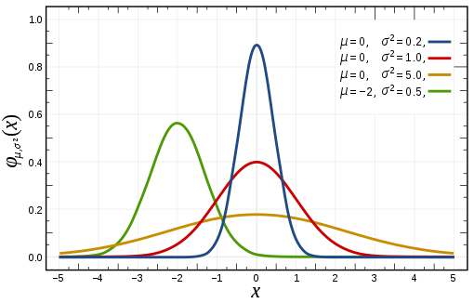
Normal Distribution
Mean: Determines the location of the center of the graph
Standard Deviation: Determines the height of the graph
Notes:
https://en.wikipedia.org/wiki/Probability_density_function
Suppose bacteria of a certain species typically live 4 to 6 hours. The probability that a bacterium lives exactly 5 hours is equal to zero. A lot of bacteria live for approximately 5 hours, but there is no chance that any given bacterium dies at exactly 5.0000000000... hours. However, the probability that the bacterium dies between 5 hours and 5.01 hours is quantifiable. Suppose the answer is 0.02 (i.e., 2%). Then, the probability that the bacterium dies between 5 hours and 5.001 hours should be about 0.002, since this time interval is one-tenth as long as the previous. The probability that the bacterium dies between 5 hours and 5.0001 hours should be about 0.0002, and so on.
In these three examples, the ratio (probability of dying during an interval) / (duration of the interval) is approximately constant, and equal to 2 per hour (or 2 hour⁻¹). For example, there is 0.02 probability of dying in the 0.01-hour interval between 5 and 5.01 hours, and (0.02 probability / 0.01 hours) = 2 hour⁻¹. This quantity 2 hour⁻¹ is called the probability density for dying at around 5 hours. Therefore, the probability that the bacterium dies at 5 hours can be written as (2 hour⁻¹) dt. This is the probability that the bacterium dies within an infinitesimal window of time around 5 hours, where dt is the duration of this window. For example, the probability that it lives longer than 5 hours, but shorter than (5 hours + 1 nanosecond), is (2 hour⁻¹)×(1 nanosecond) ≈ 6×10⁻¹³ (using the unit conversion 3.6×10¹² nanoseconds = 1 hour).
There is a probability density function f with f(5 hours) = 2 hour⁻¹. The integral of f over any window of time (not only infinitesimal windows but also large windows) is the probability that the bacterium dies in that window.

Slide 53
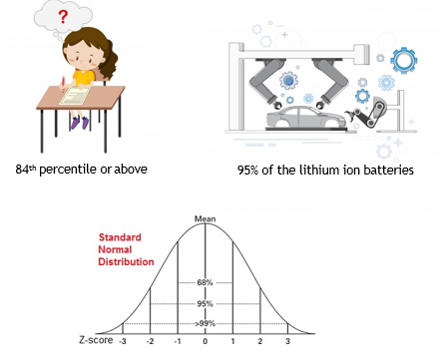
Normal Distribution
What is Normal Distribution?

Slide 54
Normal Distribution
Features of Normal Distributions
Symmetric bell shape
Mean and median are equal
The area under the normal curve is equal to 1.0
Normal distributions are denser in the center and less dense in the tails
68% of the area of a normal distribution is within one standard deviation of the mean
Approximately 95% of the area of a normal distribution is within two standard deviations of the mean

Slide 55
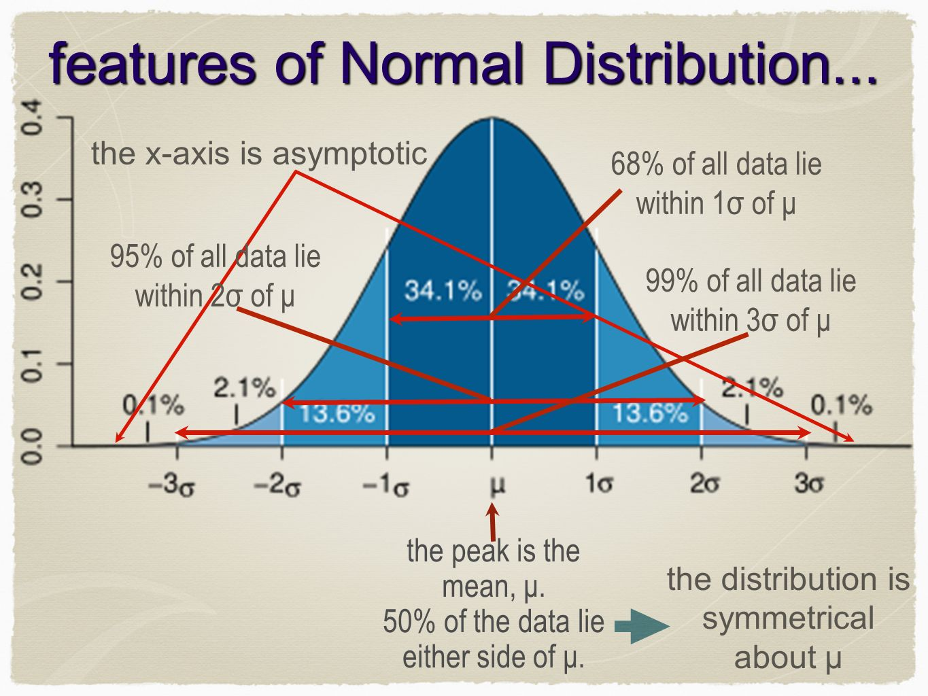
Normal Distribution
Features of Normal Distributions

Slide 56
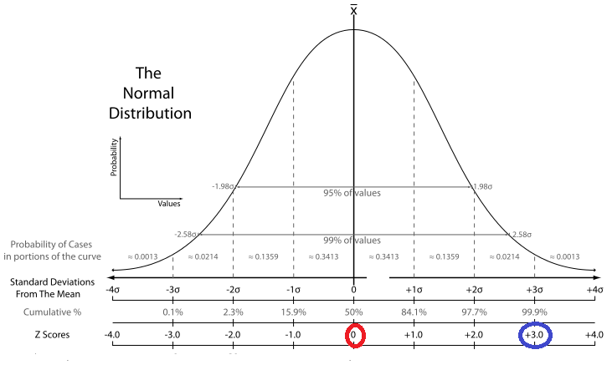
Z score
A z-score describes the position of a raw score in terms of its distance from the mean, when measured in standard deviation units.
Z-score is negative if it lies below the mean. Z-score positive if the value lies above the mean,

Slide 57
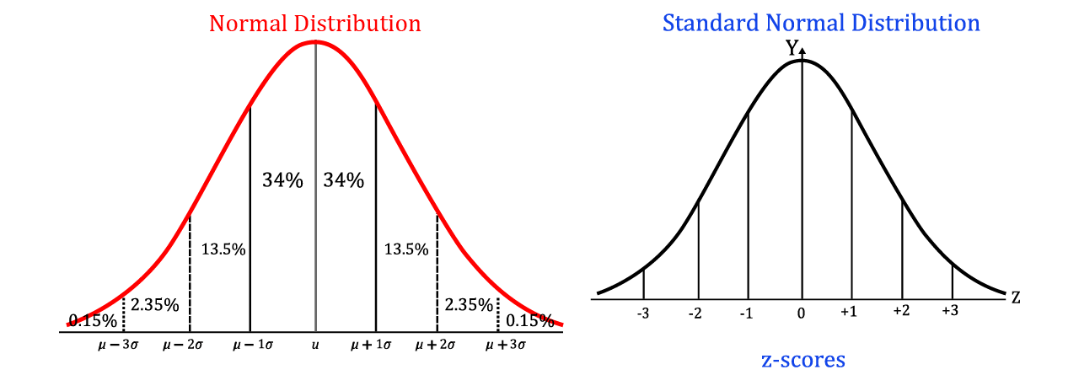
Z score
Z -Score is also known as a standard score, because it allows comparison of scores on different kinds of variables by standardizing the distribution.
A standard normal distribution (SND) is a normally shaped distribution with a mean of 0 and a standard deviation (SD) of 1

Slide 58
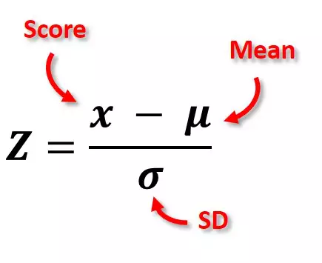
Z-score (population)
x- Random Variable,
Raw Score
Z -Score

Slide 59
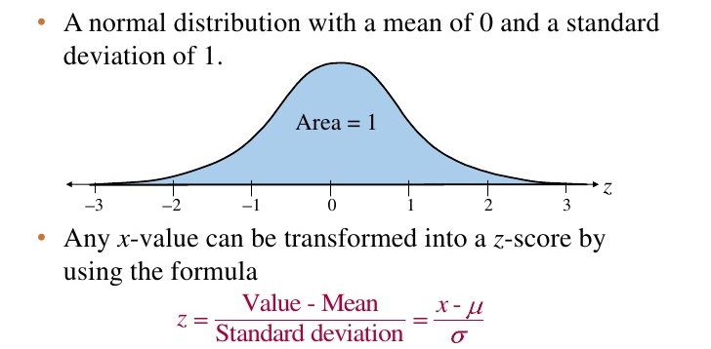
Standard Normal Distribution

Slide 60
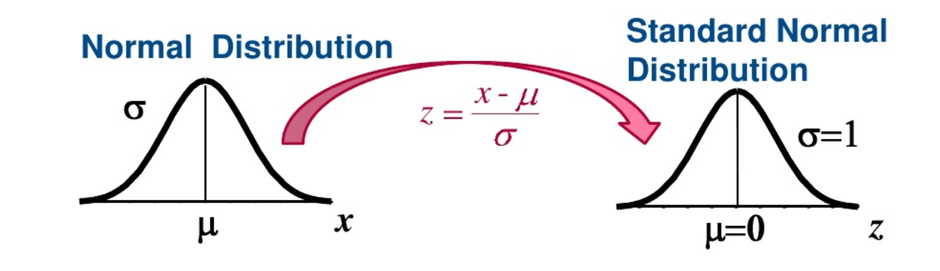
Normal Distribution to Standard Normal Distribution

Slide 61
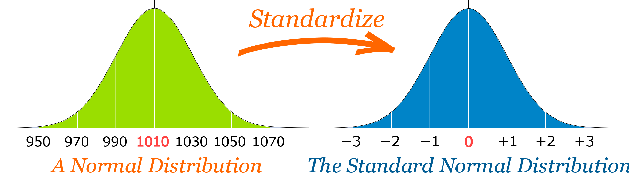
Normal Distribution to Standard Normal Distribution

Slide 62
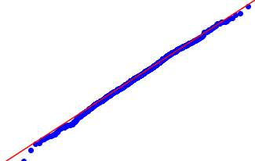
Q and Q Plot
QQ plots are a quick and visual way to assess whether a variable is normally distributed or not – below we have a Normal Plot
Notes:
https://www.geeksforgeeks.org/qqplot-quantile-quantile-plot-in-python/#:~:text=qqplot%20(Quantile%2DQuantile%20Plot)%20in%20Python,with%20respect%20to%20the%20locations.
https://towardsdatascience.com/what-in-the-world-are-qq-plots-20d0e41dece1
Draw a normal distribution plot
https://www.tutorialspoint.com/python_data_science/python_normal_distribution.htm

Slide 63
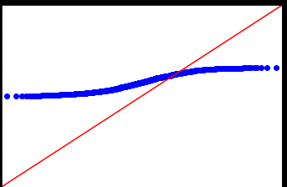
Q and Q Plot
QQ plots are a quick and visual way to assess whether a variable is normally distributed or not - below we have below is NOT Normal Plot
Notes:
https://www.geeksforgeeks.org/qqplot-quantile-quantile-plot-in-python/#:~:text=qqplot%20(Quantile%2DQuantile%20Plot)%20in%20Python,with%20respect%20to%20the%20locations.
https://towardsdatascience.com/what-in-the-world-are-qq-plots-20d0e41dece1
Draw a normal distribution plot
https://www.tutorialspoint.com/python_data_science/python_normal_distribution.htm

Slide 64
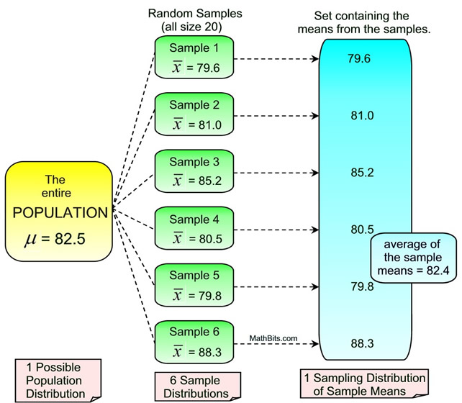
Sampling Variation
Notes:
https://www.geeksforgeeks.org/qqplot-quantile-quantile-plot-in-python/#:~:text=qqplot%20(Quantile%2DQuantile%20Plot)%20in%20Python,with%20respect%20to%20the%20locations.
https://towardsdatascience.com/what-in-the-world-are-qq-plots-20d0e41dece1
Draw a normal distribution plot
https://www.tutorialspoint.com/python_data_science/python_normal_distribution.htm

Slide 65
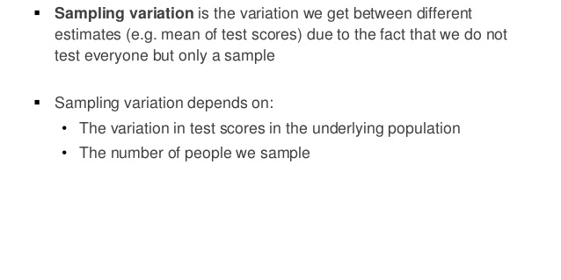
Sampling Variation
Notes:
https://www.geeksforgeeks.org/qqplot-quantile-quantile-plot-in-python/#:~:text=qqplot%20(Quantile%2DQuantile%20Plot)%20in%20Python,with%20respect%20to%20the%20locations.
https://towardsdatascience.com/what-in-the-world-are-qq-plots-20d0e41dece1
Draw a normal distribution plot
https://www.tutorialspoint.com/python_data_science/python_normal_distribution.htm

Slide 66
CENTRAL LIMIT THEOREM

Slide 67

Central LIMIT THEOREM
Notes:
https://www.geeksforgeeks.org/qqplot-quantile-quantile-plot-in-python/#:~:text=qqplot%20(Quantile%2DQuantile%20Plot)%20in%20Python,with%20respect%20to%20the%20locations.
https://towardsdatascience.com/what-in-the-world-are-qq-plots-20d0e41dece1
Draw a normal distribution plot
https://www.tutorialspoint.com/python_data_science/python_normal_distribution.htm

Slide 68
Central LIMIT THEOREM
The Central Limit Theorem states that the sampling distribution of the sample means approaches a normal distribution as the sample size gets larger — no matter what the shape of the population distribution.
This fact holds especially true for sample sizes over 30. All this is saying is that as you take more samples, especially large ones, your graph of the sample means will look more like a normal distribution.
Notes:
https://www.geeksforgeeks.org/qqplot-quantile-quantile-plot-in-python/#:~:text=qqplot%20(Quantile%2DQuantile%20Plot)%20in%20Python,with%20respect%20to%20the%20locations.
https://towardsdatascience.com/what-in-the-world-are-qq-plots-20d0e41dece1
Draw a normal distribution plot
https://www.tutorialspoint.com/python_data_science/python_normal_distribution.htm

Slide 69
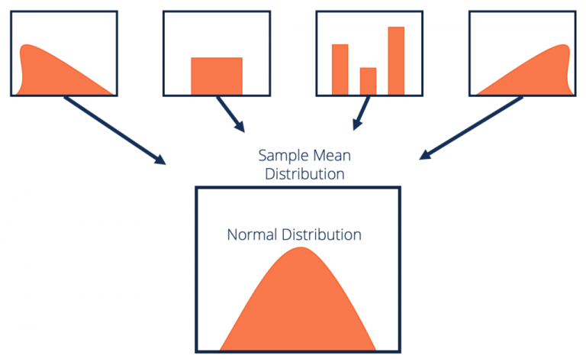
Central LIMIT THEOREM
The Central Limit Theorem states that the sampling distribution of the sample means approaches a normal distribution as the sample size gets larger
Notes:
https://www.geeksforgeeks.org/qqplot-quantile-quantile-plot-in-python/#:~:text=qqplot%20(Quantile%2DQuantile%20Plot)%20in%20Python,with%20respect%20to%20the%20locations.
https://towardsdatascience.com/what-in-the-world-are-qq-plots-20d0e41dece1
Draw a normal distribution plot
https://www.tutorialspoint.com/python_data_science/python_normal_distribution.htm

Slide 70
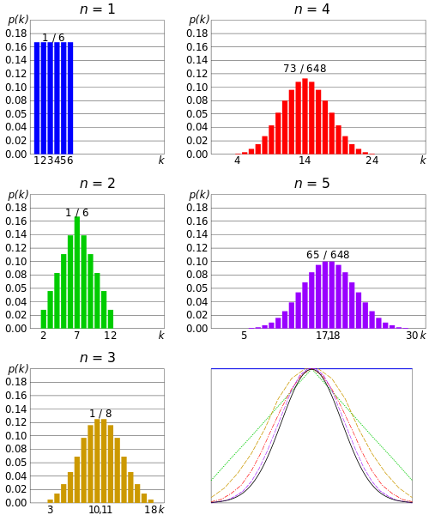
Central LIMIT THEOREM
Notes:
https://www.geeksforgeeks.org/qqplot-quantile-quantile-plot-in-python/#:~:text=qqplot%20(Quantile%2DQuantile%20Plot)%20in%20Python,with%20respect%20to%20the%20locations.
https://towardsdatascience.com/what-in-the-world-are-qq-plots-20d0e41dece1
Draw a normal distribution plot
https://www.tutorialspoint.com/python_data_science/python_normal_distribution.htm

Slide 71
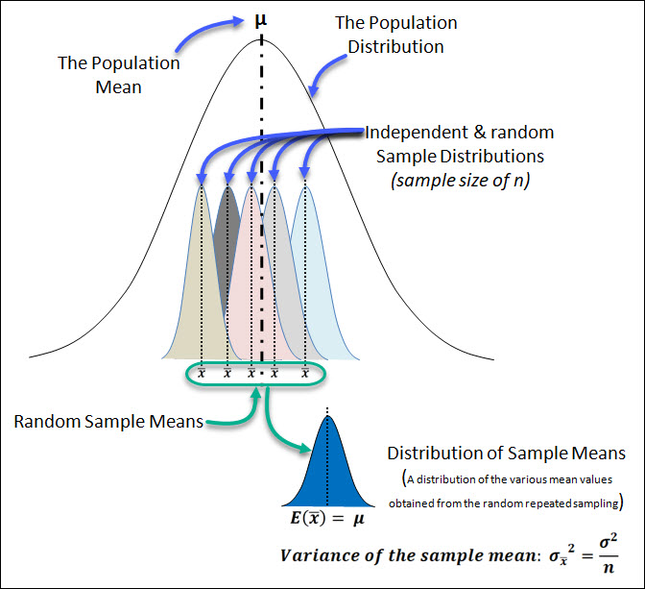
Expected Value E(x)
“In probability theory, the central limit theorem (CLT) states that, given certain conditions, the arithmetic mean of a sufficiently large number of iterates of independent random variables, each with a well-defined expected value and well-defined variance, will be approximately normally distributed, regardless of the underlying distribution.

Slide 72
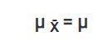
Central LIMIT THEOREM
The mean of the sample means is denoted as below
and is always equal to the population Mean (mu)
where,
µ _{X̄} = Mean of the sample means
µ= Population mean
Notes:
https://www.geeksforgeeks.org/qqplot-quantile-quantile-plot-in-python/#:~:text=qqplot%20(Quantile%2DQuantile%20Plot)%20in%20Python,with%20respect%20to%20the%20locations.
https://towardsdatascience.com/what-in-the-world-are-qq-plots-20d0e41dece1
Draw a normal distribution plot
https://www.tutorialspoint.com/python_data_science/python_normal_distribution.htm

Slide 73
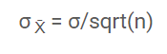
Central LIMIT THEOREM
The standard deviation of the sample mean is denoted by
σ _{X̄} = Standard deviation of the sample mean
σ = Population standard deviation
n = sample size
The Standard Deviation of the distribution of Sample means is ALSO called the STANDARD ERROR
Notes:
https://www.geeksforgeeks.org/qqplot-quantile-quantile-plot-in-python/#:~:text=qqplot%20(Quantile%2DQuantile%20Plot)%20in%20Python,with%20respect%20to%20the%20locations.
https://towardsdatascience.com/what-in-the-world-are-qq-plots-20d0e41dece1
Draw a normal distribution plot
https://www.tutorialspoint.com/python_data_science/python_normal_distribution.htm

Slide 74
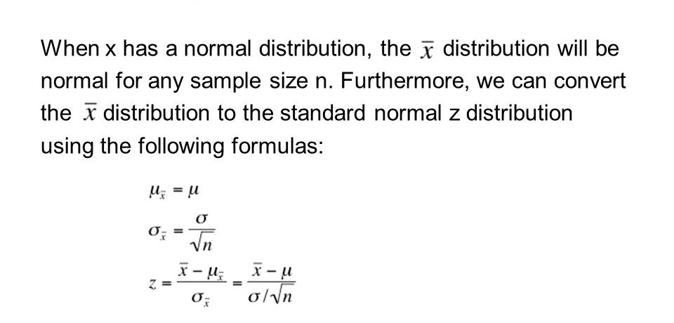
Central LIMIT THEOREM
σ _{X̄} = Standard deviation of the sample mean
σ = Population standard deviation
n = sample size
Notes:
https://www.youtube.com/watch?v=huha4OQGlFM

Slide 75
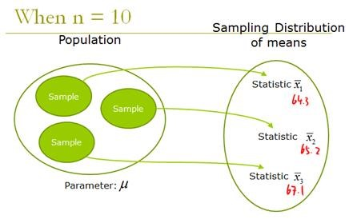
Central LIMIT THEOREM
Notes:
Statistical Significance of CLT
Analyzing data involves statistical methods like hypothesis testing and constructing confidence intervals. These methods assume that the population is normally distributed. In the case of unknown or non-normal distributions, we treat the sampling distribution as normal according to the central limit theorem
If we increase the samples drawn from the population, the standard deviation of sample means will decrease. This helps us estimate the population mean much more accurately
Also, the sample mean can be used to create the range of values known as a confidence interval (that is likely to consist of the population mean)

Slide 76
CONFIDENCE INTERVAL

Slide 77
Degrees of Freedom
The number of degrees of freedom is the number of values in the final calculation of a statistic that are free to vary. The number of independent ways by which a dynamic system can move, without violating any constraint imposed on it, is called number of degrees of freedom.
Notes:
Degrees of freedom encompasses the notion that the amount of independent information you have limits the number of parameters that you can estimate. Typically, the degrees of freedom equal your sample size minus the number of parameters you need to calculate during an analysis. It is usually a positive whole number.
https://statisticsbyjim.com/hypothesis-testing/degrees-freedom-statistics/#:~:text=In%20statistics%2C%20the%20degrees%20of,probability%20distributions%2C%20and%20regression%20analysis.

Slide 78
Degrees of Freedom –Freedom to vary
Constraints:
You have only 7 hats. Yet you want to wear a different hat every day of the week.
On the first day, you can wear any of the 7 hats. On the second day, you can choose from the 6 remaining hats, on day 3 you can choose from 5 hats, and so on.

Slide 79
Definition of Degrees of Freedom
Degrees of freedom are the number of independent values that a statistical analysis can estimate. You can also think of it as the number of values that are free to vary as you estimate parameters.
Notes:
Estimating Parameters Imposes Constraints on the Data
As you can see, that last number has no freedom to vary. It is not an independent piece of information because it cannot be any other value. Estimating the parameter, the mean in this case, imposes a constraint on the freedom to vary. The last value and the mean are entirely dependent on each other. Consequently, after estimating the mean, we have only 9 independent pieces of information, even though our sample size is 10.
That’s the basic idea for degrees of freedom in statistics. In a general sense, DF are the number of observations in a sample that are free to vary while estimating statistical parameters. You can also think of it as the amount of independent data that you can use to estimate a parameter.
https://statisticsbyjim.com/hypothesis-testing/degrees-freedom-statistics/#:~:text=In%20statistics%2C%20the%20degrees%20of,probability%20distributions%2C%20and%20regression%20analysis.

Slide 80
CONFIDENCE INTERVAL
A confidence interval is a type of estimate computed from the statistics of the observed data. This proposes a range of plausible values for an unknown parameter. The interval has an associated confidence level that the true parameter is in the proposed range.

Slide 81
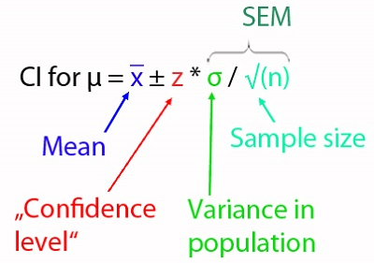
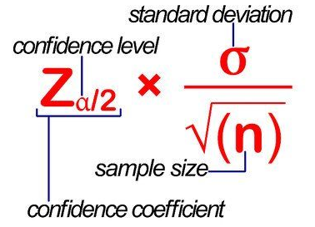
CONFIDENCE INTERVAL
SEM: Standard Error of Measurement
Margin of Error
(Point Estimate)

Slide 82
CONFIDENCE INTERVAL
A confidence interval, also means - the probability that a population parameter will fall between two set values for a certain proportion of times. Confidence intervals measure the degree of uncertainty or certainty in a sampling method.

Slide 83
Point Estimate
Point estimate, is where we estimate an unknown parameter using
a single number calculated from the sample data
Interval Estimation
We estimate an unknown parameter using an interval of
values which
• Quantifies the magnitude of estimation error – with a certain confidence level
• And is likely to contain the true value of that parameter

Slide 84
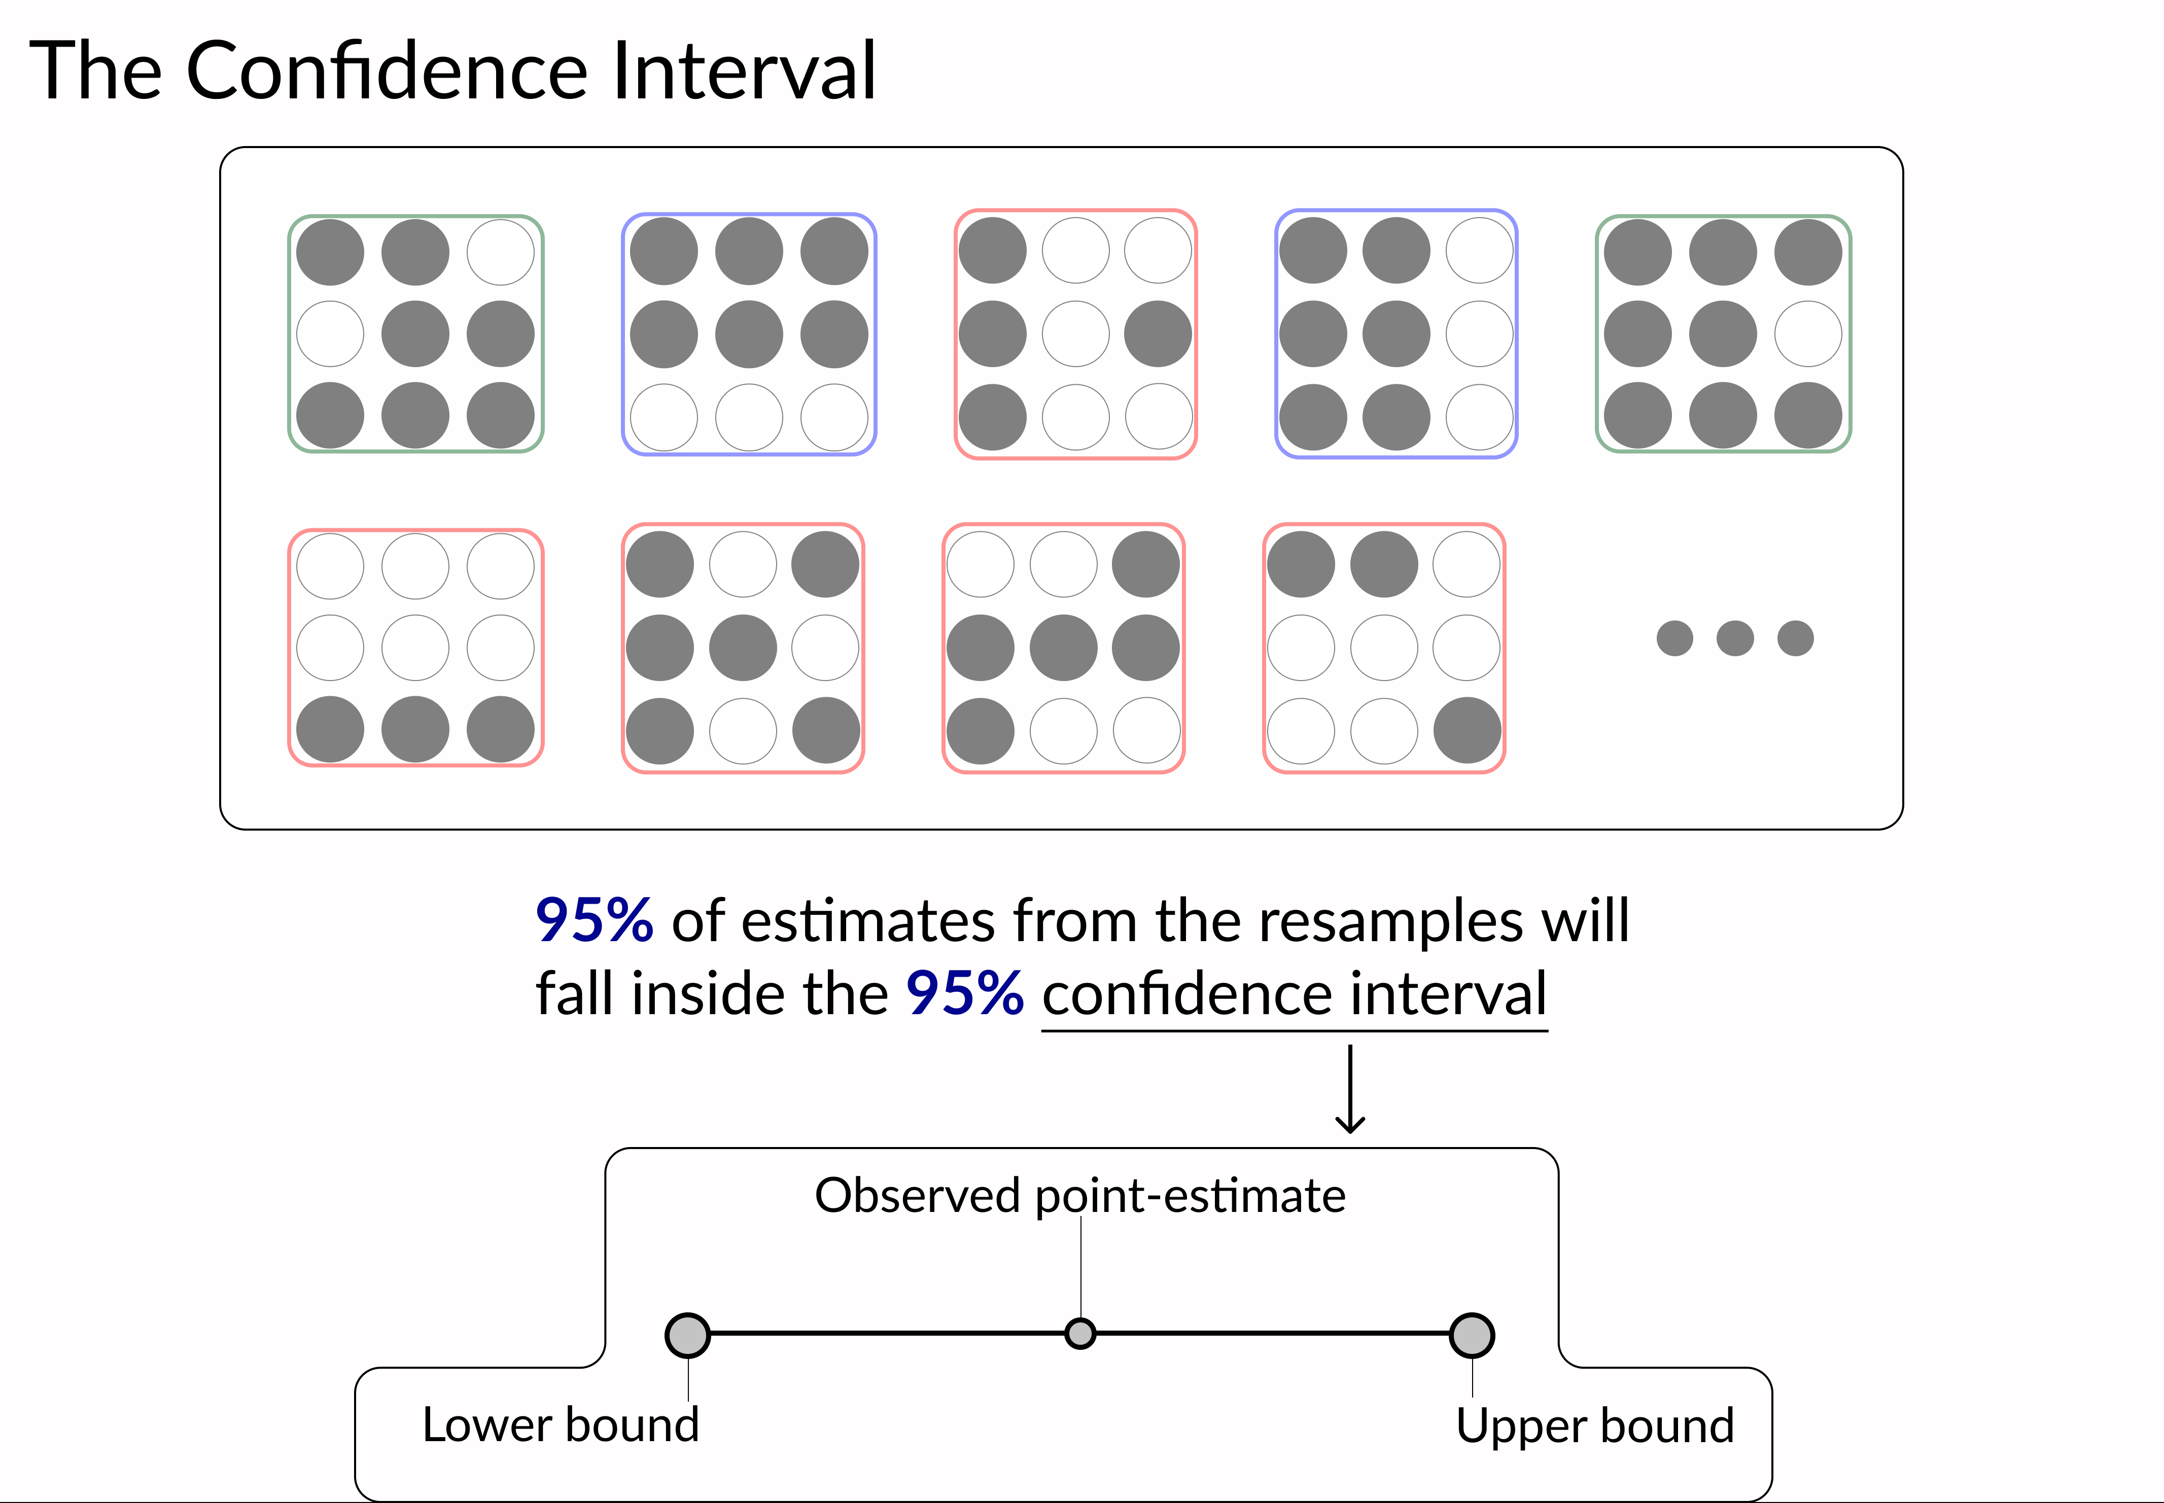
Notes:
https://www.youtube.com/watch?v=dNfpsVLaaEE

Slide 85
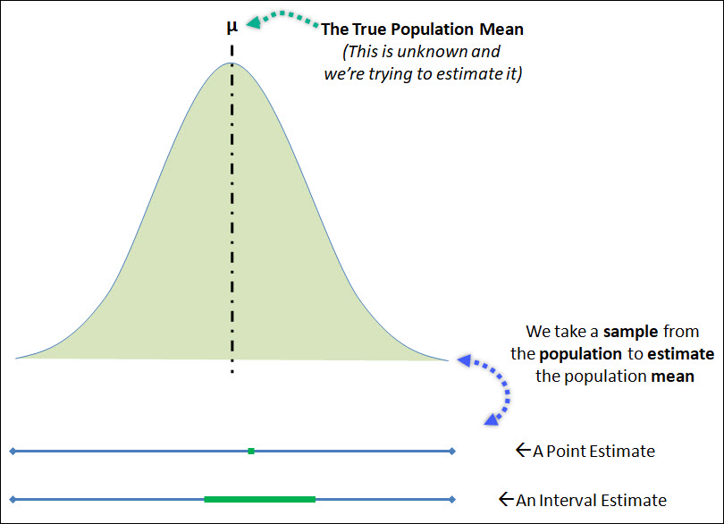
Point estimate

Slide 86
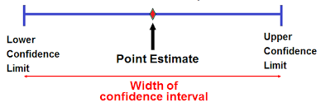
Point estimate

Slide 87

Point estimate

Slide 88

Point estimate Vs Interval Estimate

Slide 89

Margin of ERROR
The margin of error is a statistic expressing the amount of random sampling error in the results of a survey. The larger the margin of error, the less confidence one should have that a poll result would reflect the result of a survey of the entire population.
A margin of error tells you how many percentage points your results will differ from the real population value. For example, a 95% confidence interval with a 4 percent margin of error means that your statistic will be within 4 percentage points of the real population value 95% of the time.

Slide 90
Margin of ERROR
The margin of error can be calculated in two ways, depending on whether you have parameters from a population or statistics from a sample:
Margin of error = Critical value x Standard deviation for the population.
Margin of error = Critical value x Standard error of the sample.

Slide 91

MARGIN OF ERROR
A margin of error tells you how many percentage points your results will differ from the real population value. For example, a 95% confidence interval with a 4 percent margin of error means that your statistic will be within 4 percentage points of the real population value 95% of the time.
Notes:
https://en.wikipedia.org/wiki/Margin_of_error
Above, probability densities, of polls of different sizes, each color-coded to its 95% confidence interval (below), margin of error (left), and sample size (right). Each interval reflects the range within which one may have 95% confidence that the true percentage may be found, given a reported percentage of 50%. The margin of error is half the confidence interval (also, the radius of the interval). The larger the sample, the smaller the margin of error. Also, the further from 50% the reported percentage, the smaller the margin of error.

Slide 92
CONFIDENCE LEVEL
A margin of error tells you how many percentage points your results will differ from the real population value.
For example, a 95% confidence interval with a 4 percent margin of error means that your statistic will be within 4 percentage points of the real population value 95% of the time.

Slide 93

INTERVAL ESTIMATE oR CONFIDENCE INTERVAL

Slide 94
CONFIDENCE INTERVAL
SEM: Standard Error of Measurement
Margin of Error
(Point Estimate)

Slide 95

CONFIDENCE Level and Z SCORE
Critical Value
Critical Value
Notes:
https://analystnotes.com/cfa-study-notes-confidence-intervals-for-the-population-mean.html

Slide 96

Type I and Type II errors

Slide 97

Type I and Type II errors-Multi label
(TP)

Slide 98
End

